Slide 1
Floor plan
We have 20 rectangle tables. Each table is 2.4m long by 1m wide and can fit a maximum of 4.5 people per side. We have 140 timber chairs.
Place the tables into the position you wish us to have them laid out for your wedding reception:
Please move around the tables on the floor plan (next pages) as you wish us to lay them out for your wedding reception. Please only send through one layout, delete the other template slide on this document prior to sending back to us.
Maximum capacity: 150 people
White tablecloths and napkins available

Slide 2
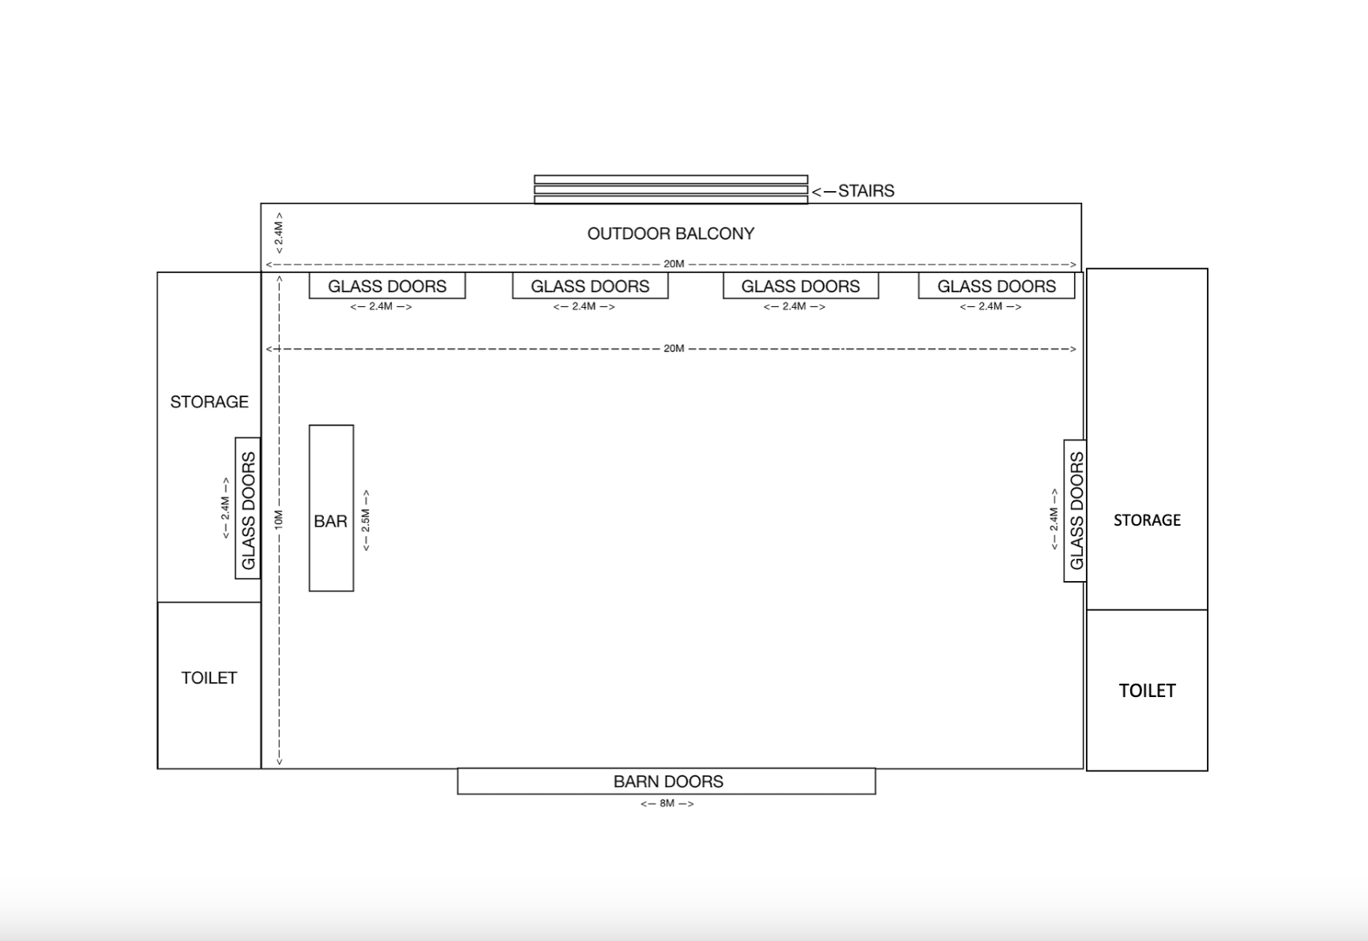
Outdoor bar
Wine barrels
Template Shows:
Maximum Capacity With Bridal Table
Firepits
White tables

Slide 3
Outdoor bar
Wine barrels
Template Shows:
Maximum Capacity Without Bridal Table
Firepits
White tables

